Slide 1




CALL A DOCTOR SYSTEM

Slide 2

PROJECT MEMBERS:
KISHEN KUMAAR A/L GANESH RAJA
VIKNES A/L THANGASPAREN
SATISH A/L PRAKASAM
ARSYAD HASSAN BIN SEGU HASAN GANI

Slide 3

THE IMPORTANCE OF HAVING A CHECKUP OR MEETING A DOCTOR
This is application where the patients can book an appointment with a doctor. Besides that , this app consist of four major roles which are the following ;
Super Admin / Project Admin
Clinic Admin
Doctor
Patient

Slide 4

PROJECT ARCHITECTURE
This application is created or developed by using android studio and the database is created by using firebase which supports real-time storage and retrieval purposes.
Besides that, session manager is implemented , in order to support multiple user role such as super admin, clinic admin, doctor and patients.

Slide 5
Vulnerabilities of the app previously before security implementation
No encryption implemented for the users.
RBAC wasn’t implemented
Lack of Input Validation
Lack of Data & Privacy Policy
The consequences that we will face if these implementations are not been used will be such as :
Data Exposure: Sensitive user data (e.g., medical records, personal information) is vulnerable to interception during communication.
Unauthorized Data Access: Users may access sensitive information or features beyond their role.
User Concerns: Absence of a clear policy discourages users from trusting the app with their private data.
Data Integrity Issues: Incorrect or malicious input can corrupt records or cause system crashes.

Slide 6

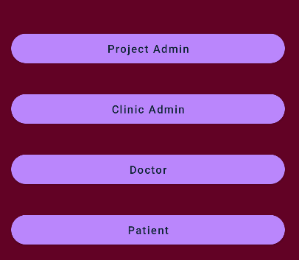
USER ROLE AND ACCESS
Project Admin/ Super Admin: This role has the access of controlling the app overall such as providing approval for the clinics that has been requested from the clinic admin.
Clinic Admin: This role has access to view the request from the patients of their appointments, create clinics, add new doctors and to assign patients to the doctors.
Doctor: This role has the access to view patient’s report , to prescribe medication and also to view the location of the patient.
Patient : This role has the access to book an appointment, to view the history of the appointments and also to view the location of the clinic’s location.

Slide 7
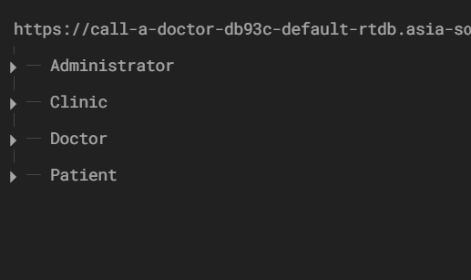

Why firebase?
It’s easier to implement and supports real-time storage efficiently for the mobile applications. Such as , instant updates where Firebase uses WebSocket connections instead of traditional HTTP, allowing data to be synchronized in real-time across all connected clients. This is especially valuable for apps like "Call a Doctor," where multiple users (doctors, patients, and admins) may need immediate access to the latest data, such as updates in medical reports or messages
Database Used

Slide 8
HOW TO REGISTER AND LOG IN TO THE APP
The admin / super admin can’t be registered but can login and approve the other requests from the other roles.
Clinic Admin – Creates new clinic and doctor
Doctor- to view and prescribe the medication for patients
Patient- Create new profile and to login

Slide 9
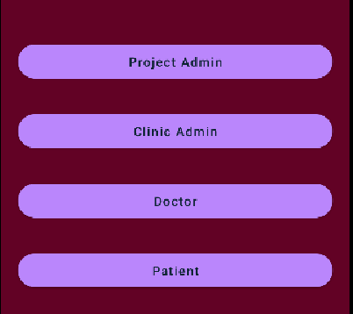
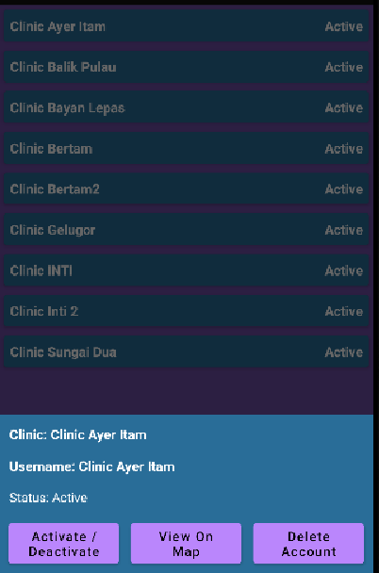
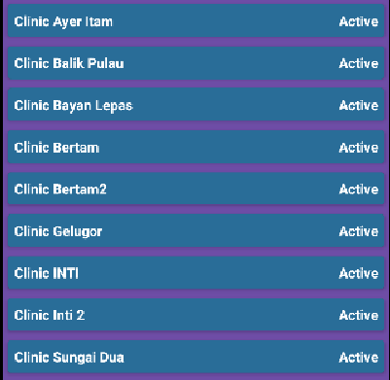
LOGIN TO CLINIC ADMIN-CREATE CLINIC AND DOCTOR
First step enter to the clinic admin and create the user
1.
First step enter to the clinic admin and create the user
Secondly, upon successful registration of the clinic, the request need to be approved by the admin.
After that, log in to clinic admin and add doctors.
2.
Click on the clinic name that you registered
3.
There will be a pop up and you can choose the actions as listed to activate ,deactivate , view location of the clinic.

Slide 10
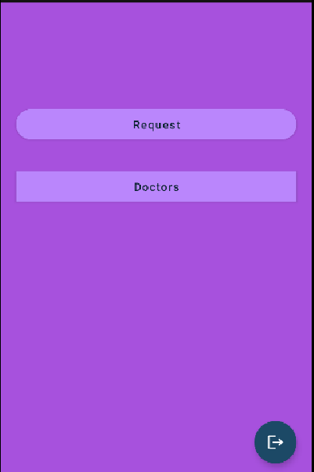
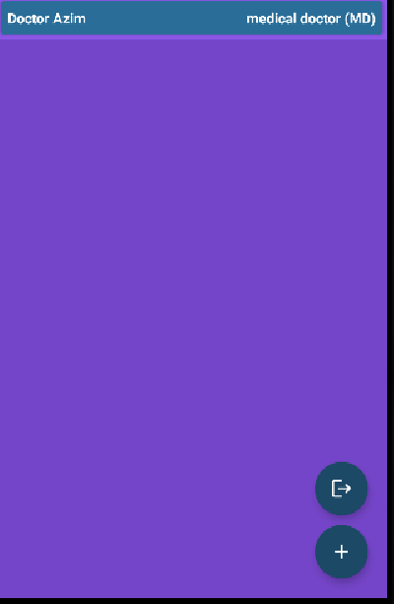
CREATING/REGISTERING DOCTOR ROLE IN CLINIC ADMIN
1.
Once log into clinic admin role, there will be options of request and doctor to view the list of appointment request of patients and list of doctors.
As you click the doctor’s tab, you will be redirected to a page of doctors list and to view the details of the doctor.
Also, to add doctors when you click the plus sign button(+)
Click the doctor button
2.
Click the (+) button to register new doctors

Slide 11
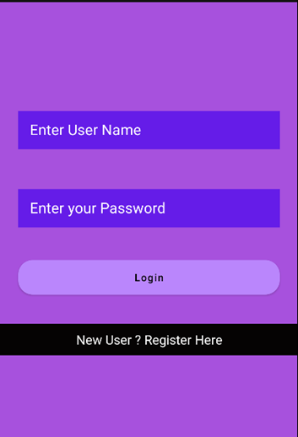
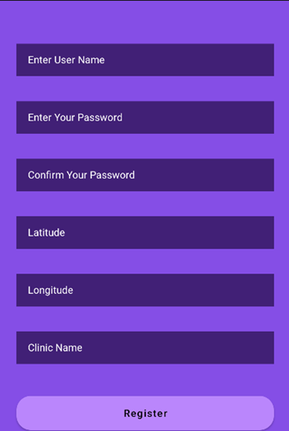
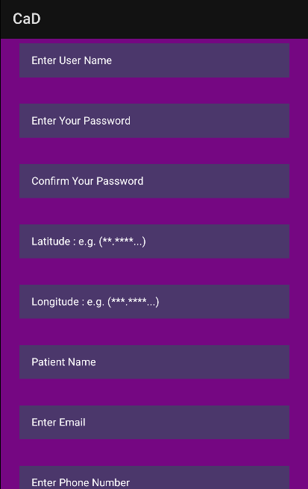
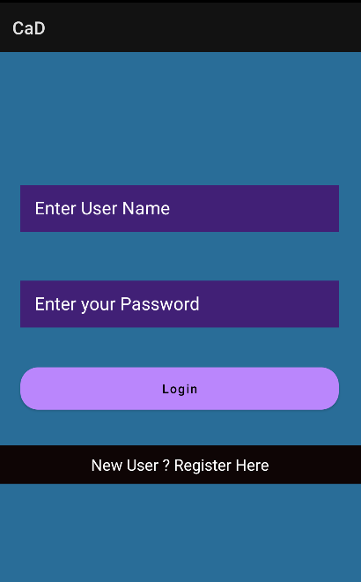
REGISTRATION , LOGIN PAGE FOR BOTH CLINIC ADMIN AND PATIENT
Example of the registration and log in page for Clinic Admin :
Example of the registration and log in page for Patient Role:

Slide 12
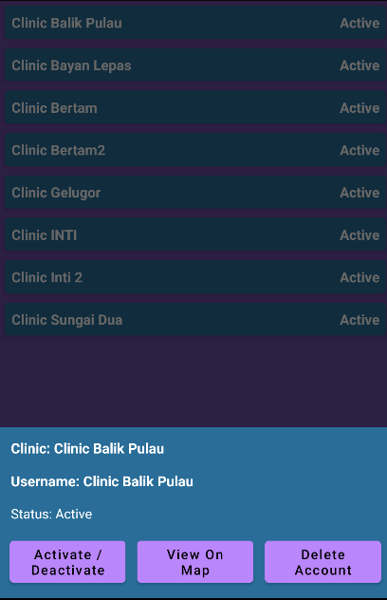
ADMIN/ SUPER ADMIN PAGE
Once the admin log in, the admin can approve the clinic which has requested to the super admin so that they can log in and register new doctors .
Besides that, clinic admin can also view the request of the patients and assign the doctor to the patient.
Super Admin can delete the clinic approval or the account of the clinic

Slide 13
SECURITY IMPLEMENTATIONS

Slide 14
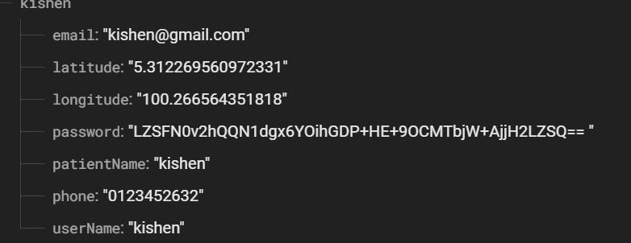
(Kishen Kumaaar)(P23014943)
REGISTRATION OF THE USER AND THE ENCRYPTION OF THE ACCOUNT. EXAMPLE; CLINIC ACCOUNT
Details saved in firebase with the encrypted password
Once registered, the account password will be encrypted and saved in the firebase.
This applies to the all the users.
Once, the user log in the encrypted password will be decrypted and shown in the logcat in the system.
2. Encrypted password been decrypted and shown in the system when user successfully log in

Slide 15
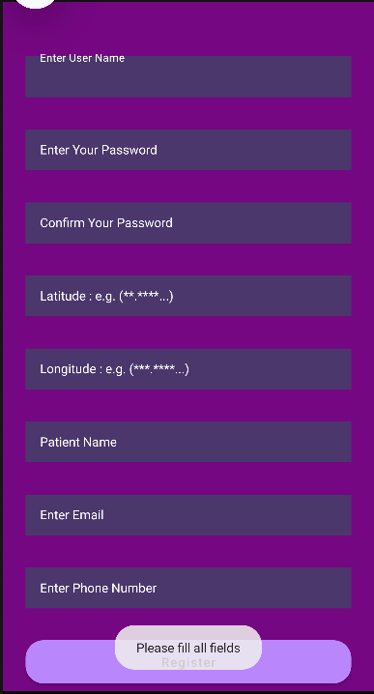
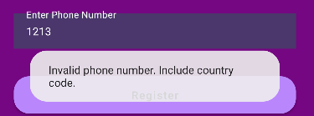
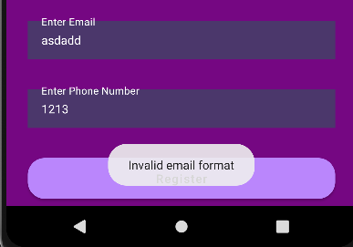
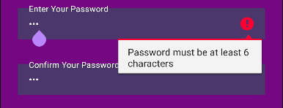
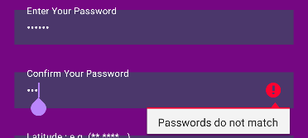
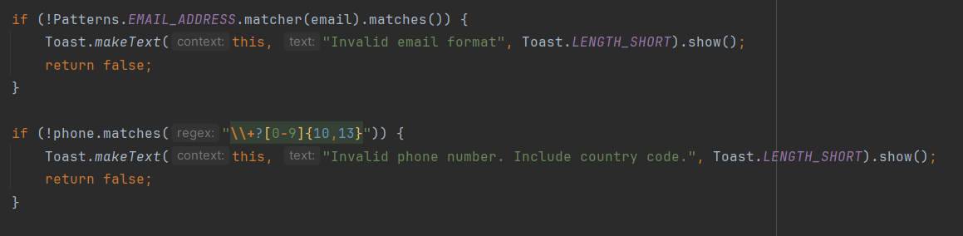
Viknes (P23014982)
User Registration Input Validation Handling
Ensures accurate patient information entry.
Validates fields like email, phone number, and password during registration and login.
Prevents invalid, incomplete, or malicious data submissions.
Improves user experience by reducing form errors.

Slide 16
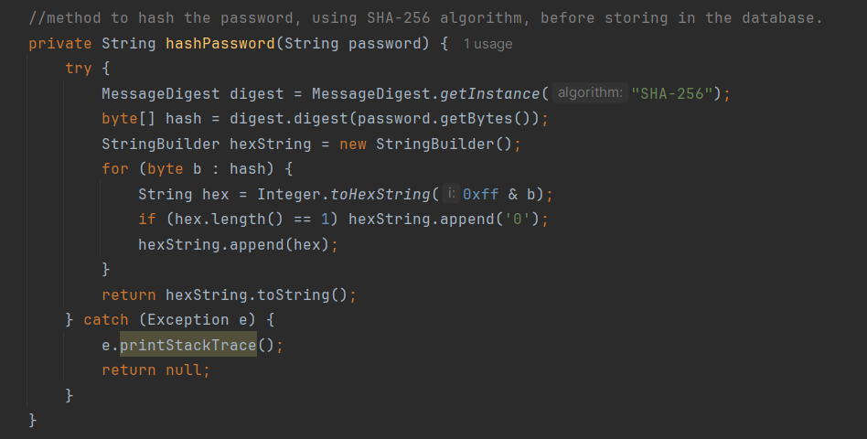
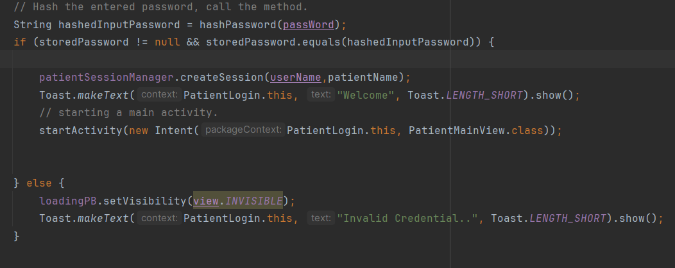
Password Hashing for User Account (Viknes, P23014982)
Protects user passwords by storing them securely.
Uses hashing algorithms (e.g., SHA-256) to prevent plain text storage.
Ensures that even if the database is breached, passwords remain secure.
And then during login, again hashes the user entered password and compares with the stored hashed password for validation. Successful login if hashed password matches.

Slide 17
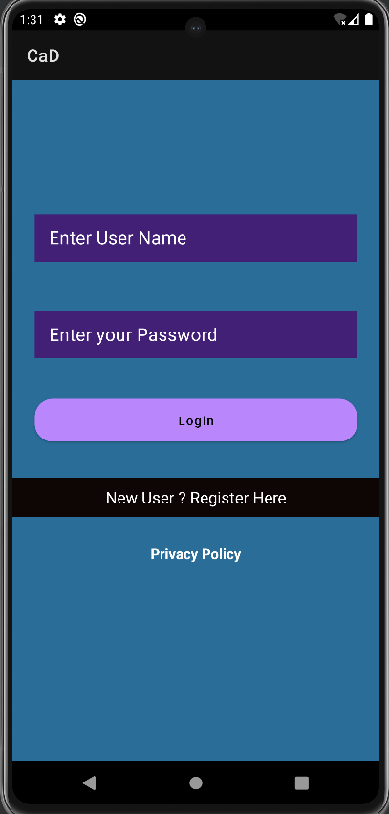
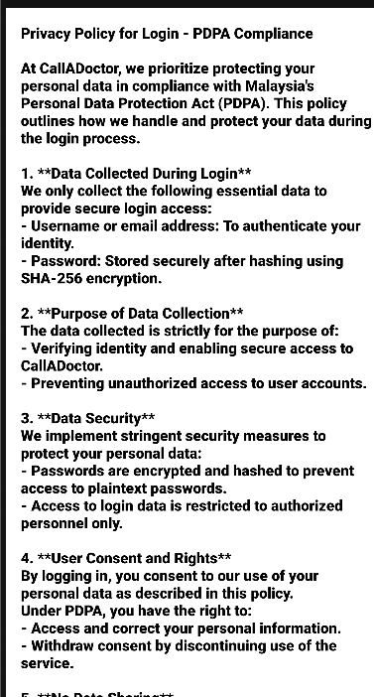
Data Privacy Policy (Viknes, P23014982)
Ensures patient data is collected, stored, and used responsibly.
Protects user confidentiality and prevents unauthorized access.
Complies with PDPA Malaysia to ensure secure handling of patient data.
Security Measures: Passwords are hashed using SHA-256, and no data is shared with third parties.

Slide 18
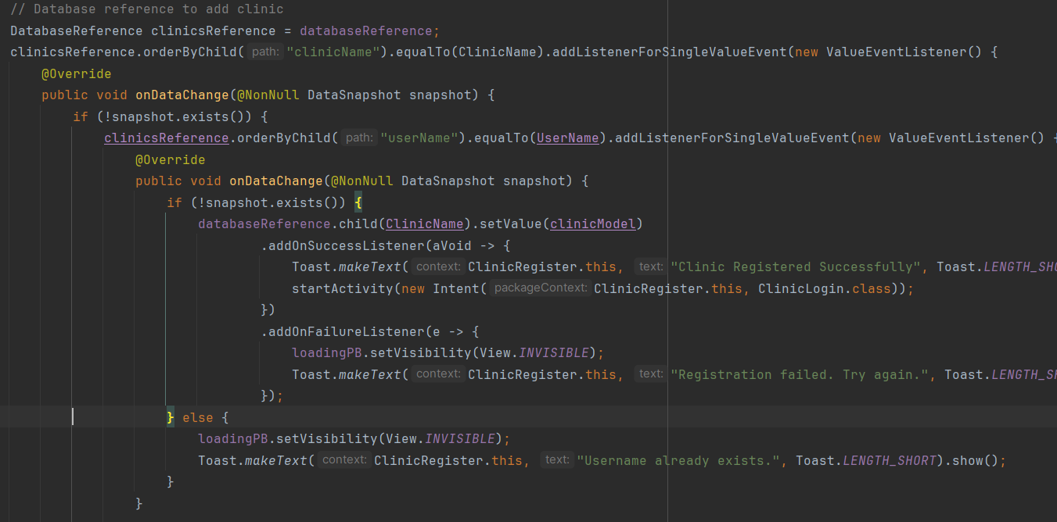
Satish ( P22014510)
Database Error Handling
Implemented mechanisms like addOnSuccessListener and addOnFailureListener to manage database insertions during registration processes.
Prevented duplicate entries using database queries with onCancelled callbacks for robust error feedback.
Ensured smooth user experience by providing instant notifications and progress management during errors.

Slide 19
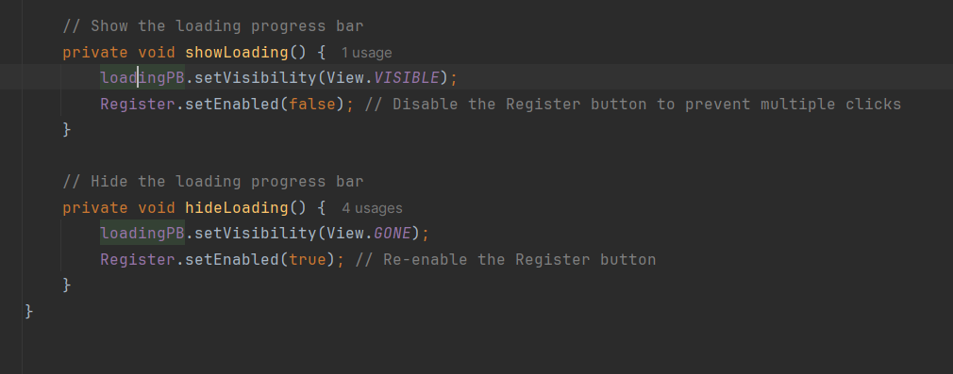
Satish ( P22014510)
UI Error Handling
Utilized methods such as showLoading() and hideLoading() to maintain responsive UI during operations.
Disabled buttons during ongoing processes to prevent duplicate submissions.
Incorporated consistent feedback mechanisms like progress bars and error messages for improved reliability and user satisfaction.

Slide 20
Satish (P22014510)
Scenario - specific error handling
Addressing Potential Faults:
Network connectivity issues and database-related problems are managed using addOnSuccessListener, addOnFailureListener, and onCancelled callbacks for different registration processes. For instance, errors due to network or database constraints during clinic, patient, or doctor registration are handled gracefully.
Customized Error Messages:
The application provides clear error messages during failures, such as notifying users about duplicate entries or failed operations, ensuring they understand the problem without exposing system-specific details.
Maintaining Application Stability:
By systematically handling errors during user registration and database interactions, the application prevents crashes and ensures a stable user experience even during unexpected situations.

Slide 21
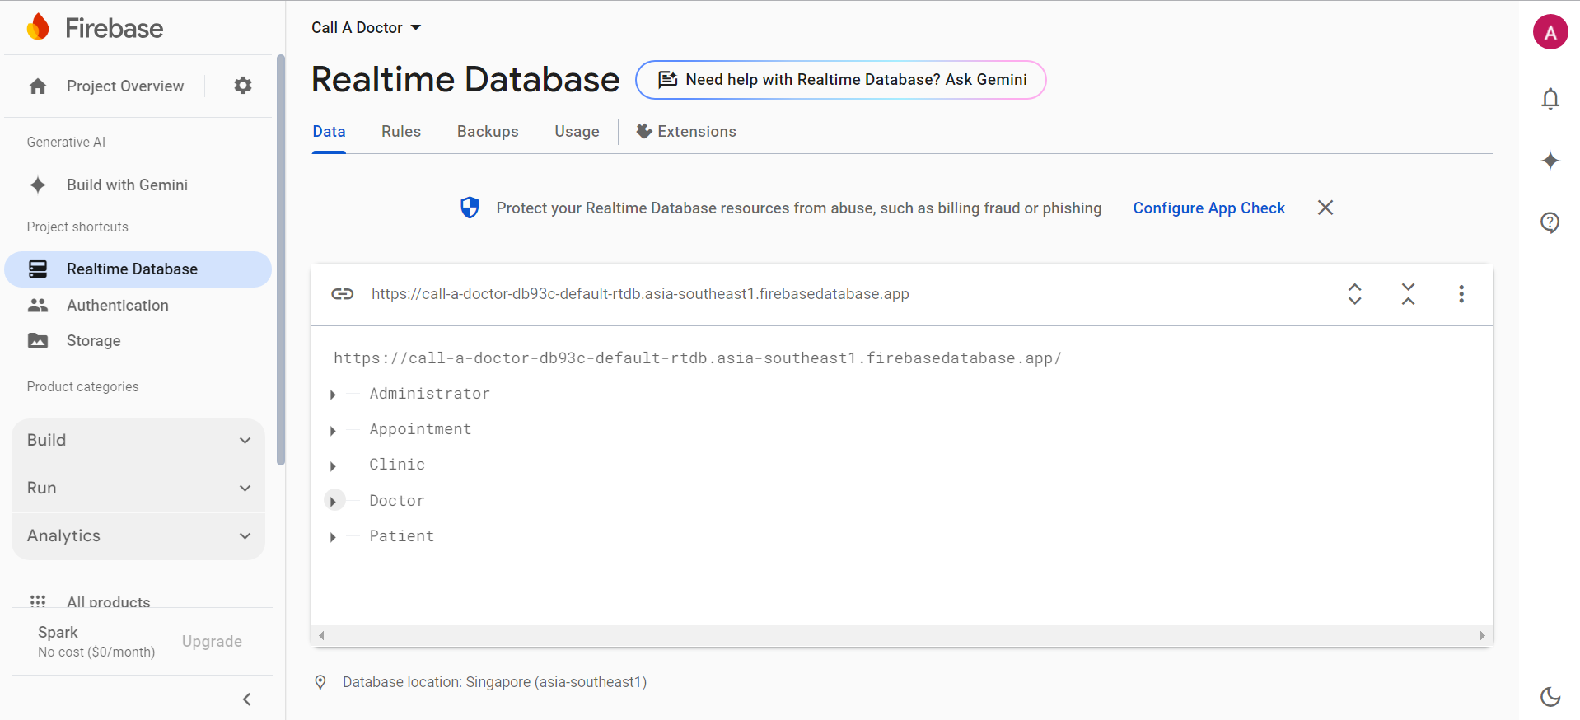
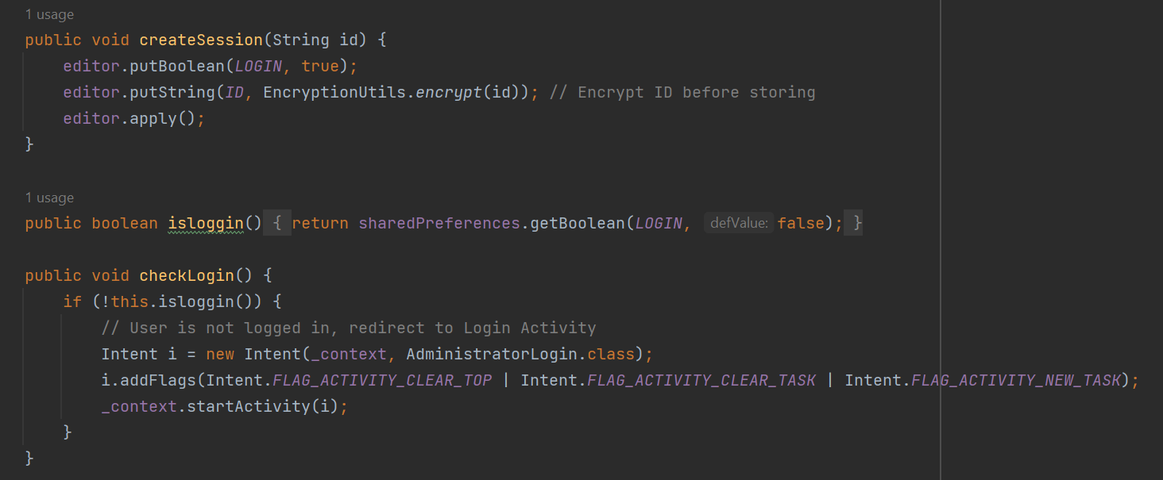
(ARSYAD )
Role-Based Access Control (RBAC)
Purpose:
Restrict access based on user roles (Administrator, Clinic, Doctor, Patient).
Implementation Highlights:
Users mapped to roles during login.
Permissions defined for each role (e.g., Administrator manages clinics, Patients book appointments).

Slide 22
FUTURE IMPROVEMENTS
Multi-factor Authentication (MFA)
Adding an extra layer of security by requiring multiple forms of identification, such as a password and a one-time code sent to a mobile device.
Granular Access Control
Allowing administrators to set specific permissions for individual features, ensuring users only have access to the functionalities they need.
Session Timeout and Token Expiration
Enhancing the handling of user sessions, automatically logging out inactive users and expiring access tokens to maintain security.

Slide 23
Github URL
https://github.com/KishenKumaarexe/CallaDoctor.git

Slide 24
THANK YOU

